Slide 1
Twitter Sentiment Analysis
Oasis Infobyte — Data Analytics Internship
Task 4: Sentiment Analysis
Presented by: Nandini Dolas

Slide 2
Objective & Dataset
Objective
Analyze tweets to understand the sentiment expressed.
Build machine-learning models to classify text sentiment.
Compare model performance using evaluation metrics.
Dataset
Dataset: Twitter Entity Sentiment Analysis
Training records: 74,682
Validation records: 1,000
Sentiment categories: Positive, Negative, Neutral, and Irrelevant
Tools Used: Python, Pandas, NLTK, Scikit-learn, Matplotlib, and Seaborn

Slide 3
Data Preprocessing
Steps performed:
Converted text to lowercase.
Removed URLs and user mentions.
Removed punctuation and special characters.
Removed common stopwords while preserving important words such as “not” and “no”.
Converted the cleaned text into numerical features using TF-IDF.
What is TF-IDF?
TF-IDF converts text into numerical values so machine-learning models can process tweets and identify informative words.
Raw Tweets
Text Cleaning
Stopword Removal
TF-IDF
Model Training

Slide 4
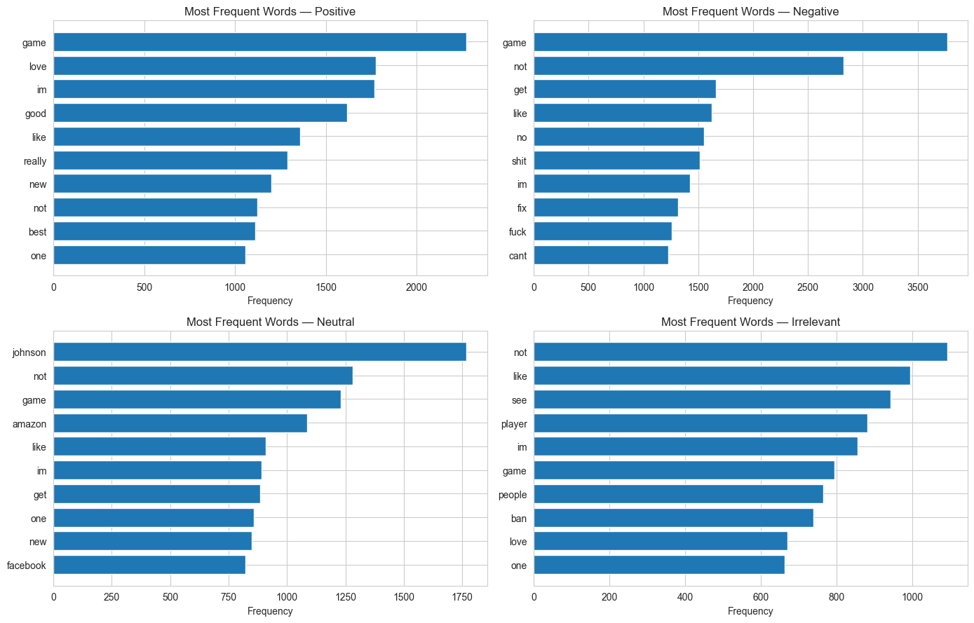
Sentiment Distribution & Word Analysis
Sentiment Distribution
Negative: 22,542 tweets
Positive: 20,832 tweets
Neutral: 18,318 tweets
Irrelevant: 12,990 tweets
Word-Frequency Analysis
Identified the most frequent words in each sentiment category.
Compared common words across Positive, Negative, Neutral, and Irrelevant tweets.
Used bar charts to visualize word frequencies.
Key Observation: Negative tweets formed the largest category in the training dataset.

Slide 5
Model Performance
Two machine-learning models were trained and evaluated.
Best Performing Model: Logistic Regression
Key Findings
Logistic Regression achieved higher accuracy than Naive Bayes.
It performed 10.6 percentage points better on the validation dataset.
Both models were evaluated using classification reports and confusion matrices.

Slide 6
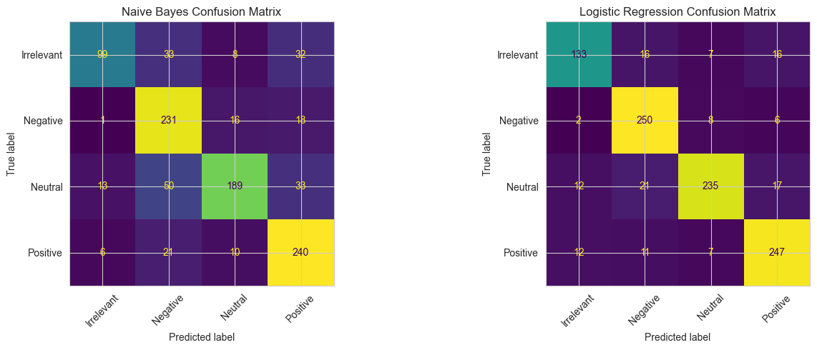
Confusion Matrix & Error Analysis
Confusion Matrix
Used to compare actual sentiment labels with model predictions.
Helped identify which sentiment categories were classified correctly or incorrectly.
Confusion matrices were generated for both Naive Bayes and Logistic Regression
Possible reasons for incorrect predictions:
Sarcasm and ambiguous expressions
Slang and spelling variations
Limited context in short tweets
Key Insight: Social media language can be challenging for machine-learning models to interpret accurately.

Slide 7
Thank You!
Oasis Infobyte — Data Analytics Internship
Task 4: Twitter Sentiment Analysis
Conclusion
Successfully classified tweets into four sentiment categories: Positive, Negative, Neutral, and Irrelevant.
Applied text preprocessing and TF-IDF for feature extraction.
Compared two machine-learning models.
Logistic Regression achieved the highest validation accuracy of 86.5%.
Sentiment analysis can help businesses understand customer feedback and public opinion.

